Slide 1



CST 347 – Real Time OS
Lecture 17 – Memory Management I
Troy Scevers

Slide 2
Introduction
Program must be brought (from disk drive) into memory and placed within a process for it to be run
  Embedded world could include flash drive
Main memory and registers are only storage CPU can access directly
Memory unit only sees a stream of address + read requests, or address/data + write requests

Slide 3
Hardware Issues
Register access in one CPU clock (or less)
Main memory can take many cycles
  Memory technology impacts (SRAM/DRAM/Flash

Slide 4
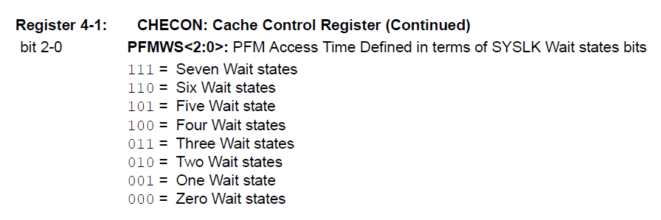
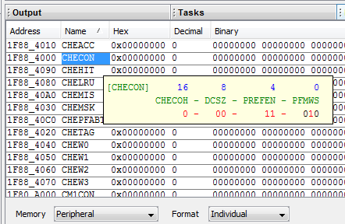
Hardware Issues
Register access in one CPU clock (or less)
Main memory can take many cycles
  Memory technology impacts (SRAM/DRAM/Flash)
CPU Clock period @ 80 Mhz:
37.5 ns versus 12.5 ns

Slide 5
Architectural/Hardware Issues
Architectural effects are encountered
  Cache sits between main memory and CPU/ registers
  Virtual memory system could be implemented

Slide 6
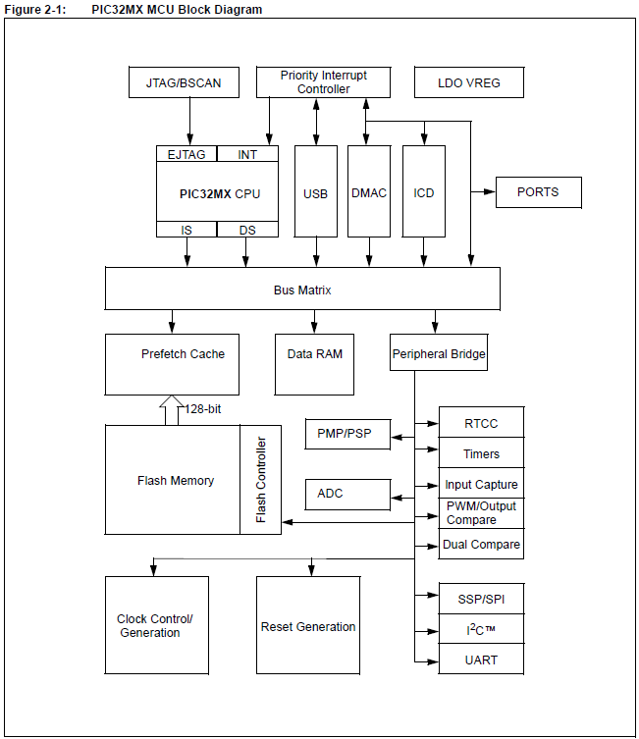
Architectural/Hardware Issues
Architectural effects are encountered
  Cache sits between main memory and CPU/ registers
  Virtual memory system could be implemented

Slide 7
Architectural/Hardware Issues
Architectural effects are encountered
  Cache sits between main memory and CPU/ registers
  Virtual memory system could be implemented
Block
Block
Word
Transfer
Transfer
Transfer
Main
CPU
Cache
Disk
Memory

Slide 8

OS Management of Hardware
All processes only execute out of memory
Each process should have its addressing capability bounded

Slide 9
OS Management of Hardware
All processes only execute out of memory
Limit registers
Memory
Management
Unit (MMU)

Slide 10
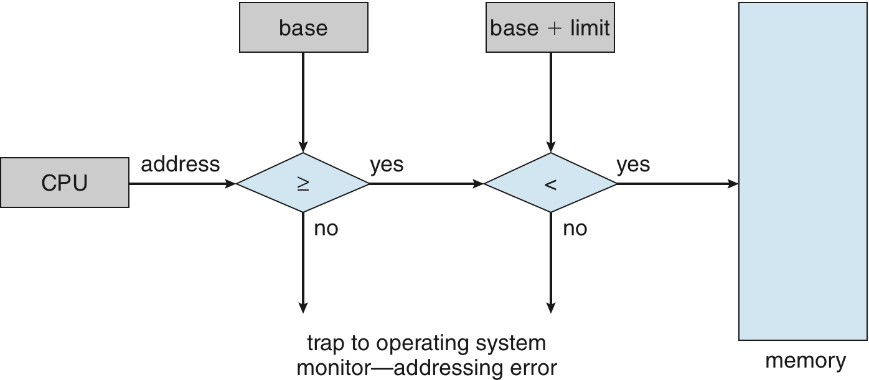
Hardware Address Protection with Base and Limit Registers

Slide 11
Address Binding
Program cannot always know available run-time address range
Addresses represented differently over lifetime of program
  Source code uses symbolic references (labels)
  Compiled code binds symbolic references to relocatable addresses
  Linker/loader binds relocatable addresses to physical addresses

Slide 12
Binding of Instructions and Data to Memory
Address binding of instructions and data to memory addresses can happen at three different stages
  Compile time: If memory location known a priori, absolute code can be generated; must recompile code if starting location changes
  Load time: Must generate relocatable code if memory location is not known at compile time
  Execution time: Binding delayed until run time if the process can be moved during its execution from one memory segment to another
    Need hardware support for address maps (e.g., base and limit registers)

Slide 13

Multistep Processing of a User Program

Slide 14
Logical vs. Physical Addresses
Logical Address – Generated by the CPU
Physical Address – Seen by memory system
MMU required
Memory Management Unit
(MMU)
CPU
Logical Address
Physical Address
Main Memory

Slide 15
Logical vs. Physical Addresses
Logical Address – Generated by the CPU
Physical Address – Seen by memory system
MMU required
CPU
Physical Address
Main Memory

Slide 16

Logical vs. Physical Addresses
Logical Address – Generated by the CPU
Physical Address – Seen by memory system
MMU required

Slide 17

Swapping
Memory requirements exceed physical memory
Time to context switch is very high

Slide 18
Memory Allocation
Single partition
Multiple partition

Slide 19
Memory Allocation
Single partition
Multiple partition
Must handle fragmentation
OS
OS
OS
OS
process 5
process 5
process 5
process 5
process 9
process 9
process 8
process 10
process 2
process 2
process 2
process 2

Slide 20
Dynamic Storage-Allocation Problem
How to satisfy a request of size n from a list of free holes?
First-fit: Allocate the first hole that is big enough
Best-fit: Allocate the smallest hole that is big enough; must search entire list, unless ordered by size
  Produces the smallest leftover hole
Worst-fit: Allocate the largest hole; must also search entire list
  Produces the largest leftover hole
First-fit and best-fit better than worst-fit in terms of speed and storage utilization

Slide 21
Fragmentation
External Fragmentation – total memory space exists to satisfy a request, but it is not contiguous
Internal Fragmentation – allocated memory may be slightly larger than requested memory; this size difference is memory internal to a partition, but not being used
First fit analysis reveals that given N blocks allocated, 0.5 N blocks lost to fragmentation
  1/3 may be unusable -> 50-percent rule

Slide 22
Fragmentation (Cont.)
Reduce external fragmentation by compaction
  Shuffle memory contents to place all free memory together in one large block
  Compaction is possible only if relocation is dynamic, and is done at execution time
  I/O problem
    Latch job in memory while it is involved in I/O
    Do I/O only into OS buffers
Now consider that backing store has same fragmentation problems

